Slide 1
Encrypting Files On The Disk
This lecture is mainly based on the power point slides by Professor Lawrie Brown.
Notes:
Zili Shao

Slide 2
Encrypting File System
Protects sensitive data on computers and laptops from physical theft.
Encryption at a lower level that all applications can use.
EFS introduced in Windows 2000
Tied to the NTFS file system
Encrypt individual files or folders

Slide 3
Protected files on disk
Disk
File 1
Alice
Alice
No eavesdropping
No tampering
File 2
Analogous to secure communication:
Alice today sends a message to Alice tomorrow
Encrypting files on disk: EFS (Encrypted File System ), TrueCrypt, Bitlocker (Hard drive encryption)
Notes:
NTFS: New Technology File System, Windows
Zili Shao

Slide 4
What is Encrypting File System (EFS)
The Microsoft Windows Encrypting File System (EFS) is feature built into the file system of the Windows XP and Windows Vista operating systems. It lets you encrypt designated files on a local computer so that no other user can access your data. When a file is encrypted, EFS automatically decrypts the file for use and re-encrypts the file when it is saved.
EFS is particularly useful for protecting data on a computer that might be physically stolen, such as a laptop.
Windows Encrypting File System (EFS)
page <number>

Slide 5
BitLocker™ Drive Encryption
BitLocker™ Drive Encryption gives you improved data protection on your Windows
  Notebooks – Often stolen, easily lost in transit
  Desktops – Often stolen, difficult to safely decommission
  Servers – High value targets, often kept in insecure locations
  All three can contain very sensitive IP and customer data
Designed to provide a transparent user experience that requires little to no interaction on a protected system
Prevents thieves from using another OS or software hacking tool to break OS file and system protections
  Prevents offline viewing of user data and OS files
  Provides enhanced data protection and boot validation
  through use of a Trusted Platform Module (TPM)
CS660 - Advanced Information Assurance - UMassAmherst

Slide 6
Disk encryption: no expansion
Sectors on disk are fixed size (e.g. 4KB)
⇒ encryption cannot expand plaintext (i.e. M = C)
⇒ must use deterministic encryption, no integrity
Lemma: if (E, D) is a det. CPA secure cipher with M=C
then (E, D) is a PRP (Pseudo Random Permutation).
⇒ every sector will need to be encrypted with a PRP

Slide 7
sector 1
sector 2
sector 3
E(k, ⋅)
E(k, ⋅)
E(k, ⋅)
sector 1
sector 2
sector 3
Problem: sector 1 and sector 3 may have same content
Leaks same information as ECB mode
Can we do better?
Notes:
Violates det. CPA assumption

Slide 8
sector 1
sector 2
sector 3
E(k₁, ⋅)
E(k₂, ⋅)
E(k₃, ⋅)
sector 1
sector 2
sector 3
Avoids previous leakage problem
… but attacker can tell if a sector is changed and then reverted
Managing keys: the trivial construction k_{t} = PRF(k, t) , t=1,…,L
Can we do better?

Slide 9
Tweakable block ciphers
Goal: construct many PRPs from a key k∈K .
Syntax: E , D : K × T × X ⟶ X
for every t∈T and k⟵K:
E(k, t, ⋅) is an invertible func. on X, indist. from random
Application: use sector number as the tweak
⇒ every sector gets its own independent PRP

Slide 10
XTS-AES Mode for Block-Oriented Storage Devices
XTS: XEX Tweakable Block Ciphertext Stealing.
Approved as an additional block cipher mode of operation by NIST in 2010
Mode is also an IEEE Standard, IEEE Std 1619-2007 by the IEEE Security in Storage Working Group (P1619).
  Standard describes a method of encryption for data stored in sector-based devices where the threat model includes possible access to stored data by the adversary
  Has received widespread industry support
Notes:
In 2010, NIST approved an additional block cipher mode of operation, XTS-AES (XEX Tweakable Block Ciphertext Stealing).
This mode is also an IEEE standard, IEEE Std 1619-2007, which was developed
by the IEEE Security in Storage Working Group (P1619). The standard describes
a method of encryption for data stored in sector-based devices where the threat
model includes possible access to stored data by the adversary. The standard has
received widespread industry support.

Slide 11
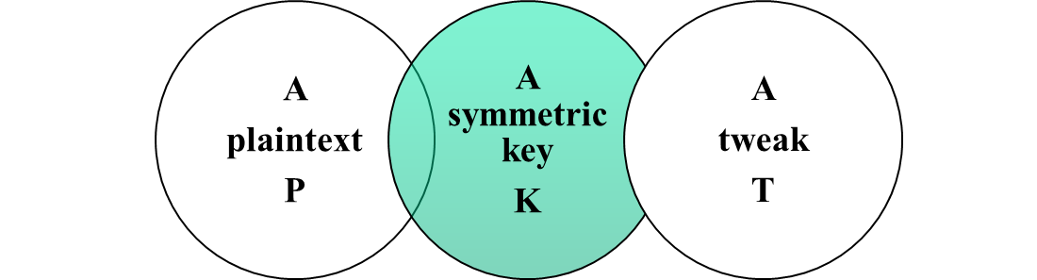
Tweakable Block Ciphers
XTS-AES mode is based on the concept of a tweakable block cipher
General structure:
  Has three inputs:
Tweak need not be kept secret
  Purpose is to provide variability
  Produces
  a ciphertext output
  C
Notes:
The XTS-AES mode is based on the concept of a tweakable block cipher , introduced
in [LISK02]. The form of this concept used in XTS-AES was first described
in [ROGA04].
Before examining XTS-AES, let us consider the general structure of a tweakable
block cipher. A tweakable block cipher is one that has three inputs: a plaintext P ,
a symmetric key K , and a tweak T ; and produces a ciphertext output C . We can
write this as C = E(K , T , P ). The tweak need not be kept secret. Whereas the purpose
of the key is to provide security, the purpose of the tweak is to provide variability.
That is, the use of different tweaks with the same plaintext and same key
produces different outputs.

Slide 12
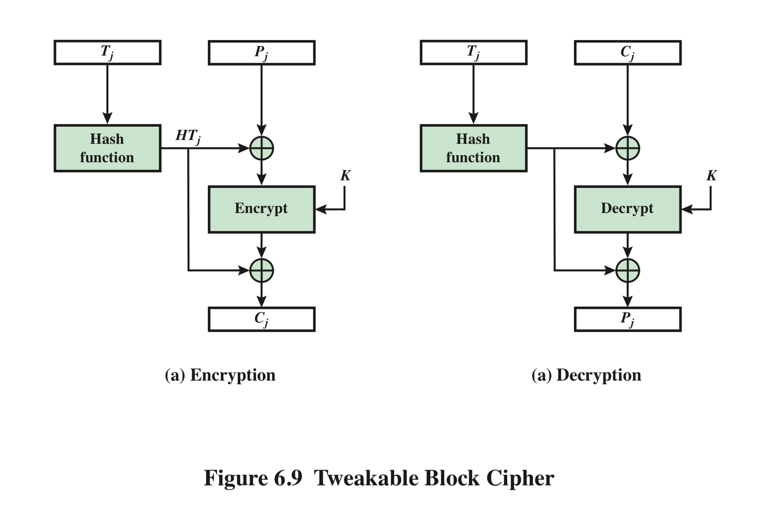
Tweakable Block Cipher
Notes:
The basic structure of several tweakable clock ciphers
that have been implemented is shown in Figure 6.9.

Slide 13
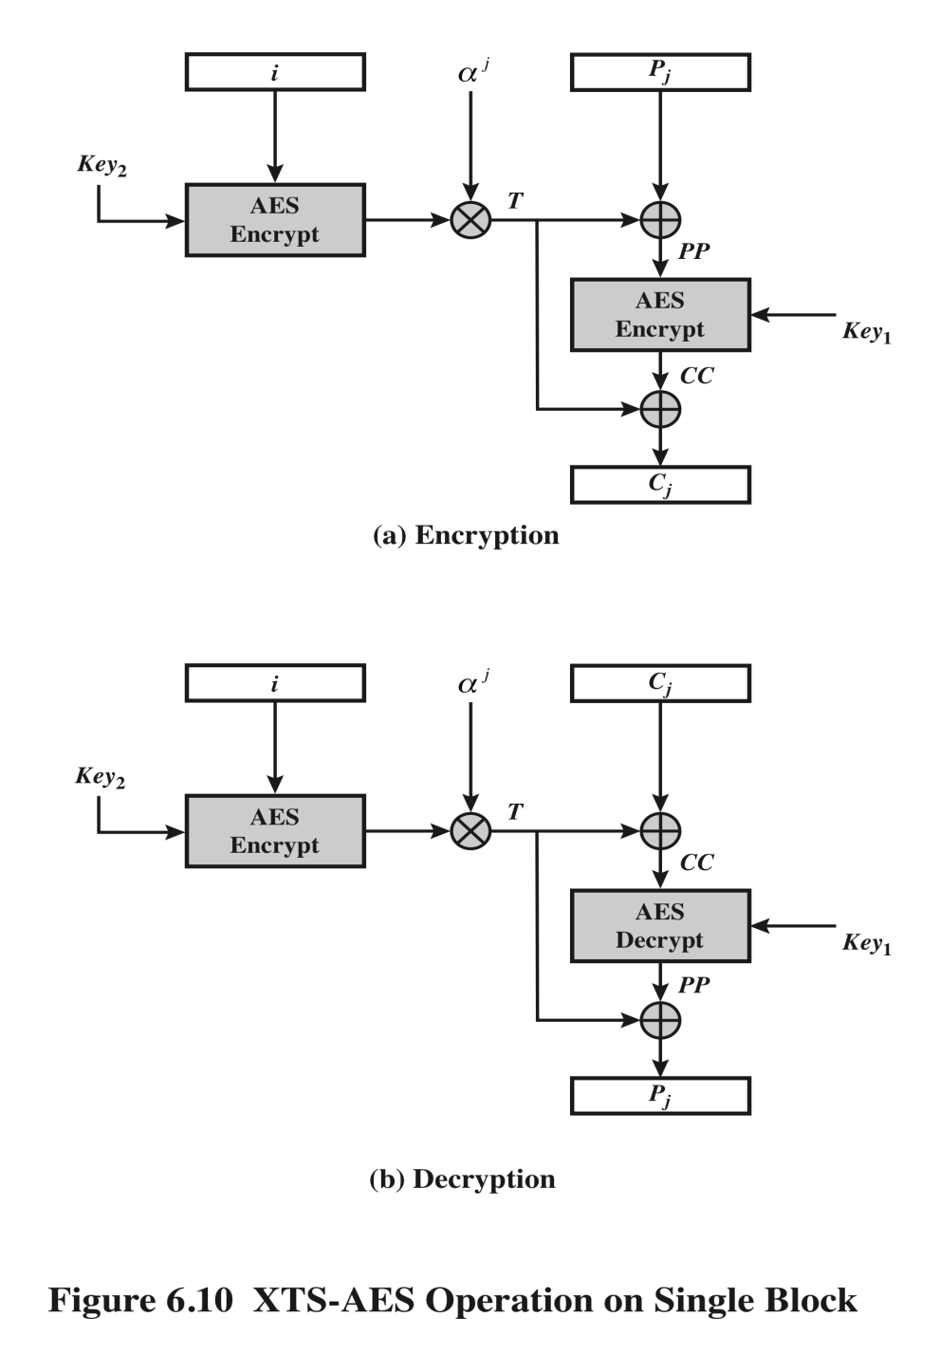
XTS-AES Operation on Single Block
Pj: the jth block of plaintext
Cj: the jth block of plaintext
Ji: 128-bit tweak: non-negative integer
Alpha: polynomial x, 000…00010
Alpha^j: alpha multiplied itself
j times in GF(2^128)
Bitwise XOR
Modulo multiplication of
two polynomials in GF (2^128)
with prime polynomial
M(x)=x^128+x^7+x^2+x+1
Notes:
Figure 6.10 shows the encryption and decryption of a single block. The operation involves
two instances of the AES algorithm with two keys.

Slide 14
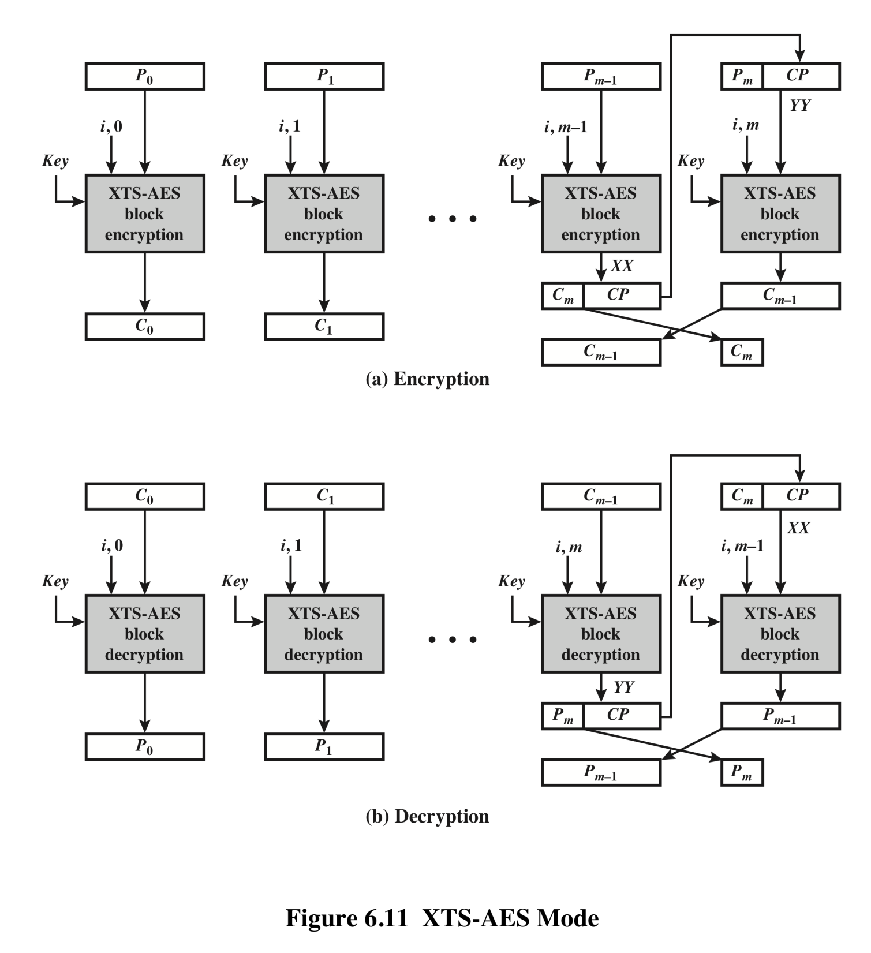
XTS–AES Mode
Notes:
The plaintext of a sector or data unit is organized into blocks of 128 bits. Blocks are
labeled P₀ , P₁ , . . . , P_{m} . The last block my be null or may contain from 1 to 127 bits.
In other words, the input to the XTS-AES algorithm consists of m 128-bit blocks
and possibly a final partial block.
As can be seen, XTS-AES mode, like CTR mode, is suitable for parallel operation.
Because there is no chaining, multiple blocks can be encrypted or decrypted
simultaneously. Unlike CTR mode, XTS-AES mode includes a nonce (the parameter
i ) as well as a counter (parameter j ).
For encryption and decryption, each block is treated independently and
encrypted/decrypted as shown in Figure 6.10. The only exception occurs when
the last block has less than 128 bits. In that case, the last two blocks are encrypted/
decrypted using a ciphertext-stealing technique instead of padding.
Figure 6.11 shows the scheme.

Slide 15
Disk encryption using XTS
sector # t:
block 1
block 2
block n
tweak:
(t,1)
tweak:
(t,2)
tweak:
(t,n)
note: block-level PRP, not sector-level PRP.
Popular in disk encryption products:
Mac OS X-Lion, TrueCrypt, BestCrypt, …

Slide 16
Summary
Use tweakable encryption when you need many
independent PRPs from one key
XTS-AES mode for block-oriented storage devices
  Storage encryption requirements
  Operation on a single block
  Operation on a sector

Slide 17
Summary
Notes:
Chapter 6 summary.

